Slide 1

intelligent automatization system
Group members
Guga esitashvili
Tea gamrekelashvili
Ana dzamelashvili
Nino nonikashvili
Uta buziashvili
Group Advisor – daviD chxaidze

Slide 2

Project plan
Date | Tasks to be completed
15/01-31/01 | Gathering all the components
01/02-28/02 | Assembling sensors and control system
01/03-14/03 | Preparing PCB, getting ready Mobile application
15/03-31/03 | Writing hardware codes
01/04-14/04 | Getting ready IOT server
15/04-30/04 | Getting all the components together, preparing visual presentation
01/05-20/05 | Simulations and error check

Slide 3
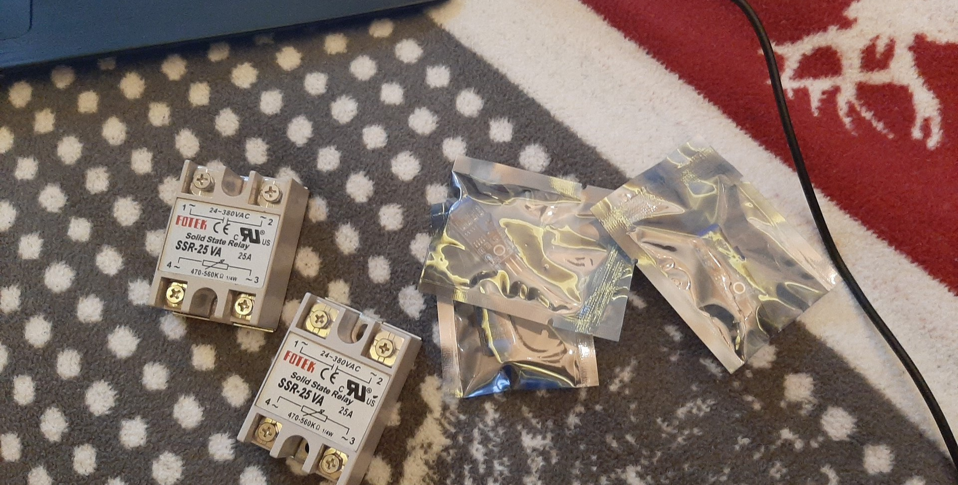
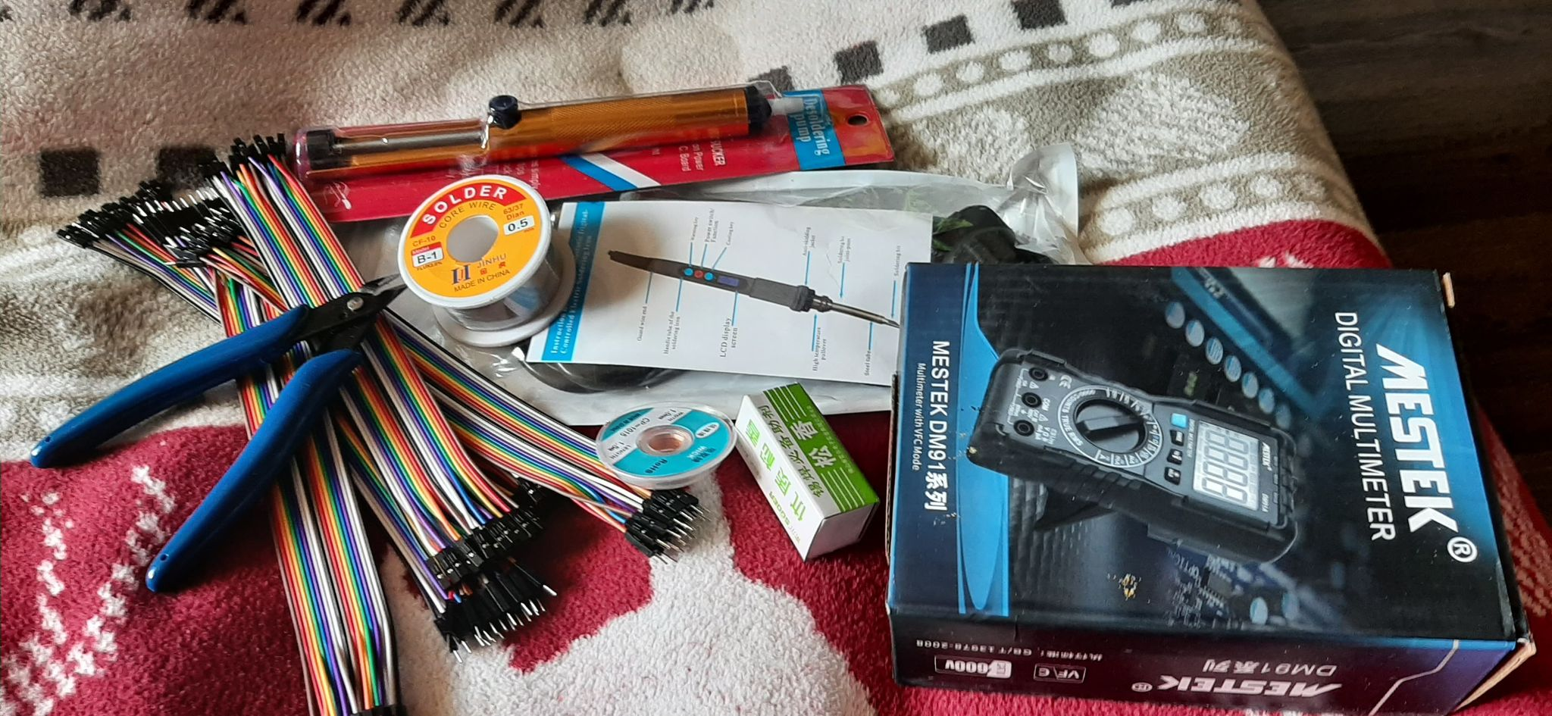
Gathering all the components

Slide 4
Hardware components
ESP WIFI module
Alarm (siren)
Light bulb
Door Lock
Raspberry pi
Gas solenoid
Servo Motors
A/D converters
CO, CO2 Sensors
Humidity Sensor
Glass Break Sensor
Temperature Sensor
Smoke Detector Sensor
Power Supply

Slide 5
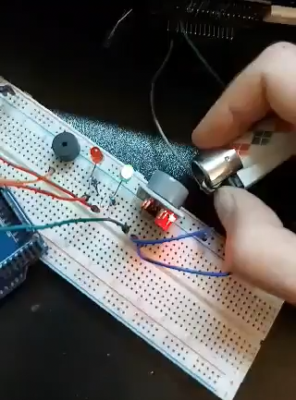
Assembling sensors and control system

Slide 6
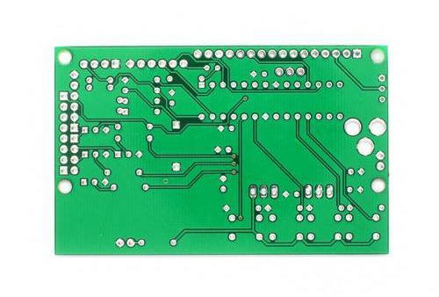

Preparing PCB, getting ready Mobile application

Slide 7

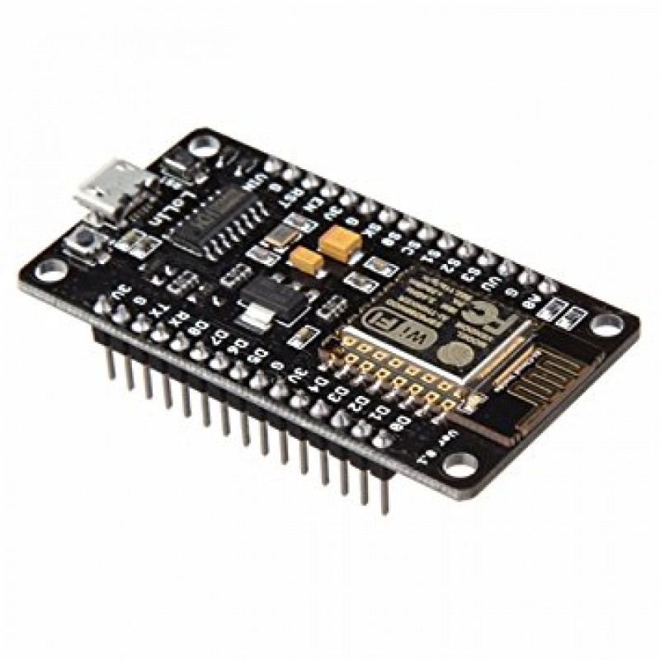
Writing hardware codes

Slide 8
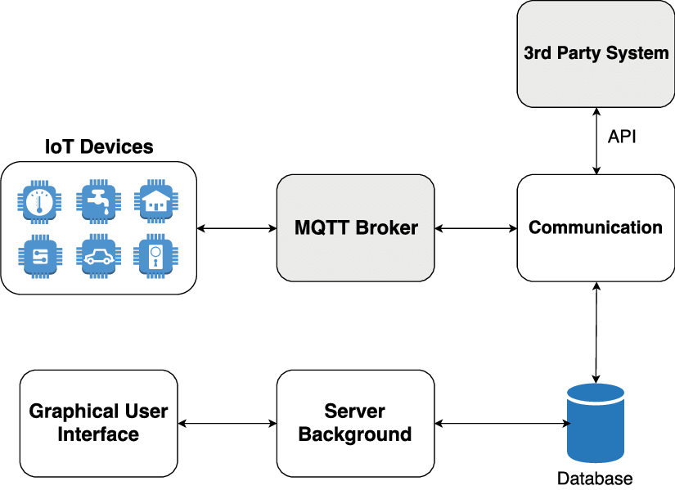
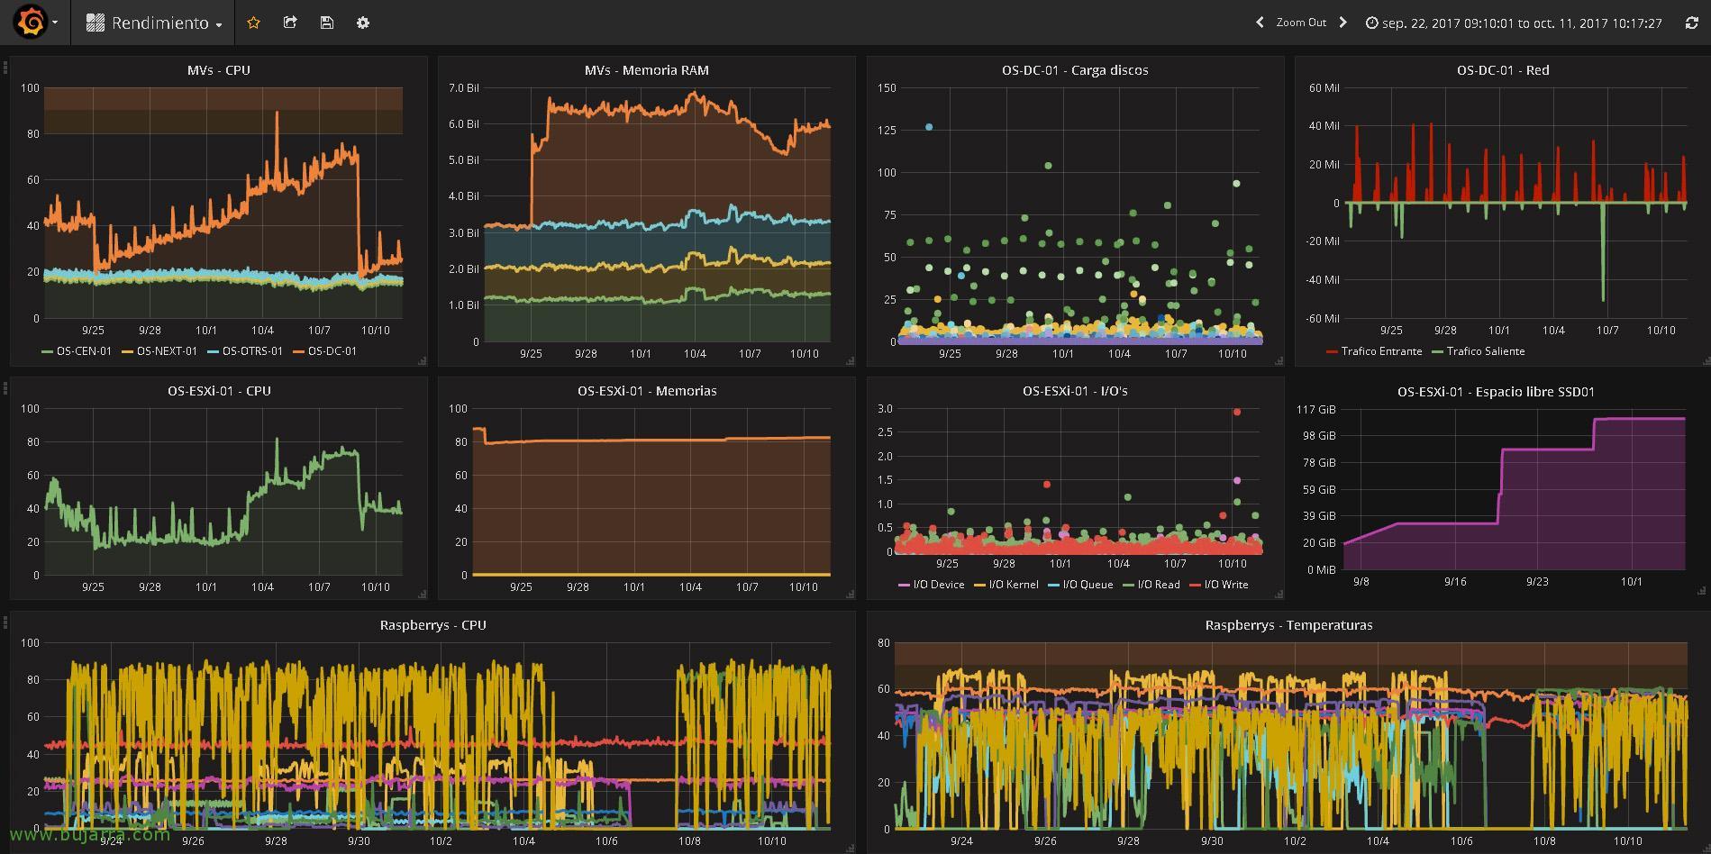
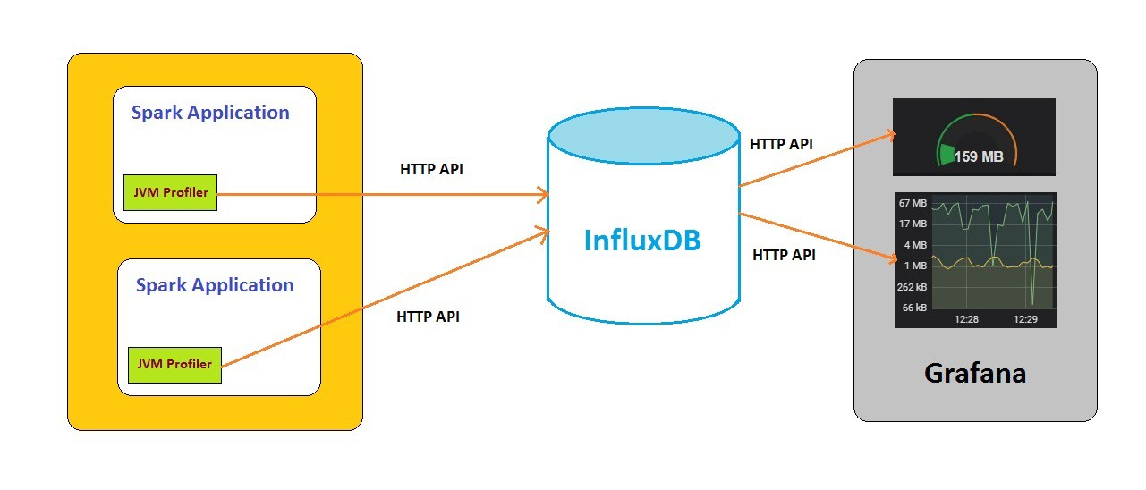
Getting ready IOT server

Slide 9
Guga Esitashvili
Developing mobile application
Tea Gamrekelashvili
MQTT protocol
Ana Dzamelashvili
Develop Web-Site
Schedule manager
Team poster editor
Technical illustrator
Team poster
Budget manager
Report editor
Software design
Nino Nonikashvili
MQTT protocol
Uta Buziashvili
Web-Site editor
Team presentation editor
hardware design
Setup IOT server
Assembling all the necessary hardware components
Setup IOT server
Assembling all the necessary hardware components
Assembling all the necessary hardware components

Slide 10

Next Steps
Getting all the components together, preparing visual presentation
Simulations and error check

